Slide 1
Digital Portfolio
STUDENT NAME: DIVYA.S
REGISTER NO AND NMID: auttvu352hc24bca018
DEPARTMENT: BCA
COLLEGE: COLLEGE/ UNIVERSITY:HOLY CROSS ARTS AND SCIENCE COLLEGE FOR WOMEN/THIRUVALLUR UNIVERSITY

Slide 2


agenda
a
Problem Statement
Project Overview
End Users
Tools and Technologies
Portfolio design and Layout
Features and Functionality
Results and Screenshots
Conclusion
3/21/2024 Annual Review

Slide 3


PROBLEM STATEMENT The system should showcase a developer’s profile, including an introduction, skills, featured projects, and contact information. The website should feature: A navigation bar with smooth scrolling and active link highlighting. A hero section with interactive animated background effects. An about section describing the developer. A skills section with animated progress bars. A projects section displaying project cards, each with live demo and source code links, and a modal view for details. A contact section with a form including client-side validation. A footer with social media links. The portfolio should be visually appealing, mobile-friendly, and interactive, serving as a professional representation of the developer’s work and abilities.”

Slide 4

PROJECT OVERVIEw
This project focuses on building a Student Registration Form using HTML, CSS, and JavaScript. The main goal is to create a simple, interactive, and responsive web page where students can input their details and register successfully.
HTML is used to design the structure of the form, including input fields (name, email, phone, password, etc.) and buttons.
CSS ensures that the form is styled professionally, with proper layout, colors, fonts, and responsiveness for different screen sizes.
JavaScript adds functionality by validating user inputs (e.g., checking if the email is in correct format, ensuring that the password meets the required length, and confirming that no field is left empty).
This project demonstrates how frontend web technologies work together to build user-friendly applications. It highlights real-world practices such as form handling, client-side validation, and responsive design.

Slide 5
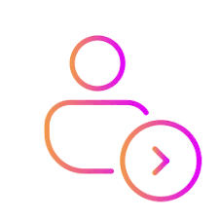

WHO ARE THE END USERS?
Developers / Coders (Yourself)
To maintain, update, and improve the portfolio site.
They use the source code (HTML, CSS, JS) to enhance functionality.
Website Visitors (Front-End Users)
They interact only with the UI (User Interface) built in your code.
They can view sections like About, Skills, Projects, and Contact.
Recruiters / Employers (Decision Makers)
They rely on your Projects Section + Contact Form from the code.
They don’t touch the code, but they use the output generated by it.
Clients / Project Owners
They use the portfolio site (generated by your code) to decide if they want to hire you.
✅ In coding terms:
The front-end code (HTML, CSS, JS) is written by you → developer user.
The rendered website (browser output) is used by → visitors, recruiters, clients.

Slide 6

TOOLS AND TECHNIQUES
Frontend Languages
CSS3 → for styling (layouts, colors, gradients, animations, responsive design).
JavaScript (ES6) → for interactivity (navigation effects, modal popups, animations, validation).
HTML5 → for structuring the content (navigation bar, sections, project cards, forms).
Frameworks / Libraries
Font Awesome → for icons (fa-github, fa-linkedin, fa-envelope, etc.).
Google Fonts (Inter) → for custom typography.
Techniques
Responsive Web Design (using CSS media queries, grid & flexbox).
Animations & Transitions (CSS keyframes: gradient shifts, floating shapes, particle effects, fade-in, bounce).
DOM Manipulation in JS (for modal, form validation, navbar scroll effects).
Intersection Observer API (for skill bars and counters animation when visible).
Client-side Form Validation (email format, required fields).
Modal Window Technique (JS-controlled project details popup).
Parallax & Interactive Background Effects (floating shapes, particles, mouse interaction).
Development Tools
Text Editor / IDE (e.g., VS Code, Sublime, etc. – assumed).
Browser Developer Tools (for testing responsiveness & debugging).

Slide 7
POTFOLIO DESIGN AND LAYOUT
Layout Structure
Navigation Bar (Header)
Fixed at the top for easy access.
Smooth scrolling with active link highlighting.
Hero Section
Full-screen introduction with animated gradient background.
Floating shapes and particles for interactivity.
Developer’s name, role, and social media links.
About Section
Two-column layout (text + image placeholder).
Statistics counters for projects completed.
Skills Section
Grid-based layout with categories (Frontend, Backend).
Animated progress bars for skill levels.
Projects Section
Responsive grid of project cards.
Each card has an image background, overlay, and action buttons (live demo, GitHub).
Modal pop-up for detailed project descriptions.
Contact Section
Two-column layout (contact details + contact form).
Client-side form validation with error messages.
Footer
Contains copyright.
Social media links for connectivity.
7

Slide 8
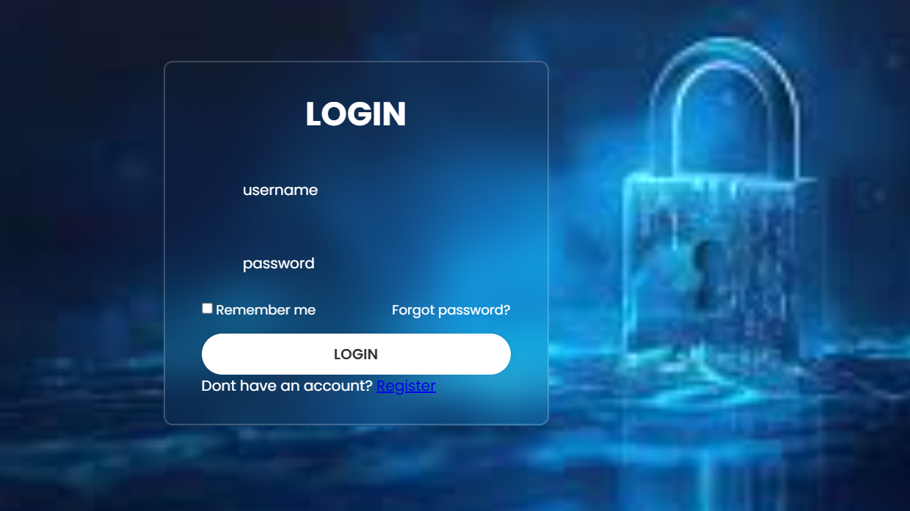
Design Techniques Used
Responsive Design: CSS Grid, Flexbox, and media queries.
Color Scheme: Gradient backgrounds (#2563eb, #7c3aed) for modern UI.
Typography: Google Font Inter for clean readability.
Interactivity: JavaScript animations, modal window, form validation.
Accessibility: Contrast colors, clear headings, semantic HTML tags.

Slide 9
FEATURES AND FUNCTIONALITY
Navigation Bar
Fixed at top.
Smooth scrolling + active link highlight.
Mobile menu with hamburger icon.
Hero Section
Animated gradient background with floating shapes & particles.
Shows name, role, short intro.
Social media icons + call-to-action buttons.
About Section
Developer intro + profile placeholder.
Stats counters (projects completed, etc.).
Skills Section
Frontend & Backend skill categories.
Animated progress bars (using JS + Intersection Observer).
Projects Section
Grid of project cards with overlay effects.
Buttons: live demo, GitHub, modal preview
6..Contact Section
Contact info (email, phone, location).
Contact form with JS validation.
Error messages for invalid input.
Footer
Copyright info.
Social media links (GitHub, LinkedIn, Twitter).
7.Interactive Elements (JS)
Modal pop-up for project details.
Animated counters and skill bars.
Particle background effect.
Responsive behavior on different screen sizes.

Slide 10
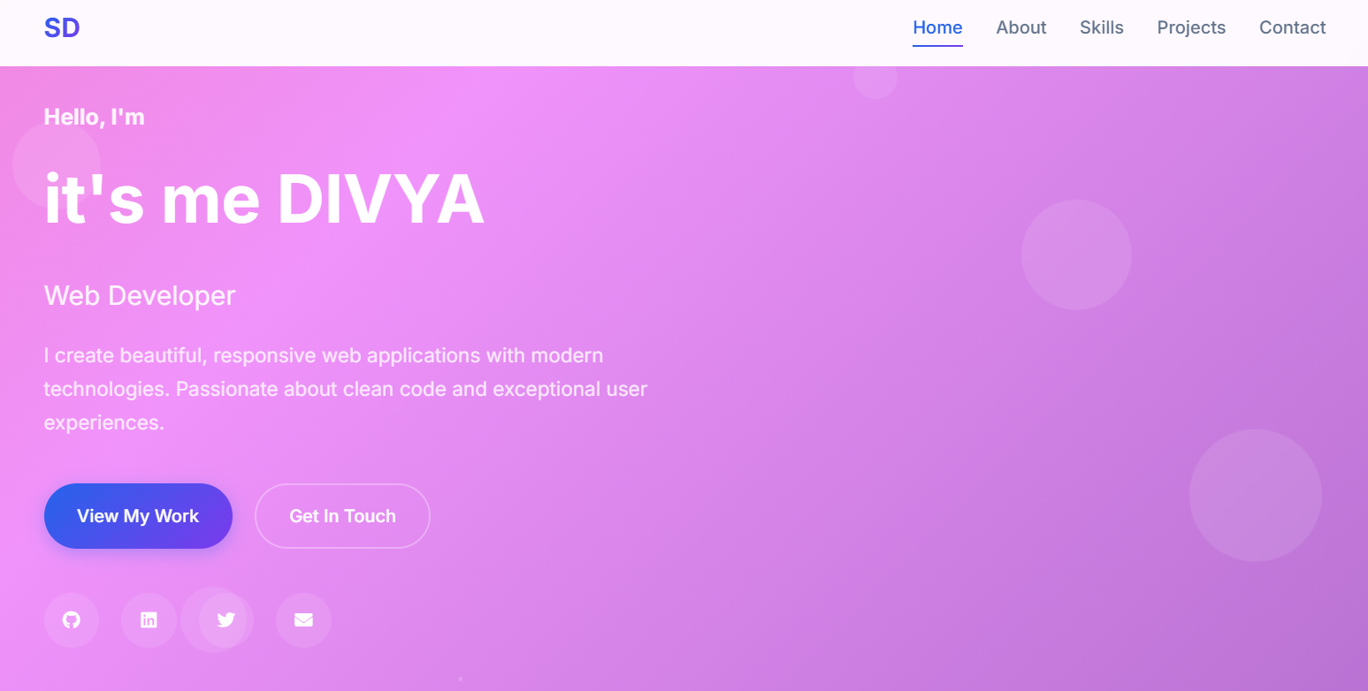
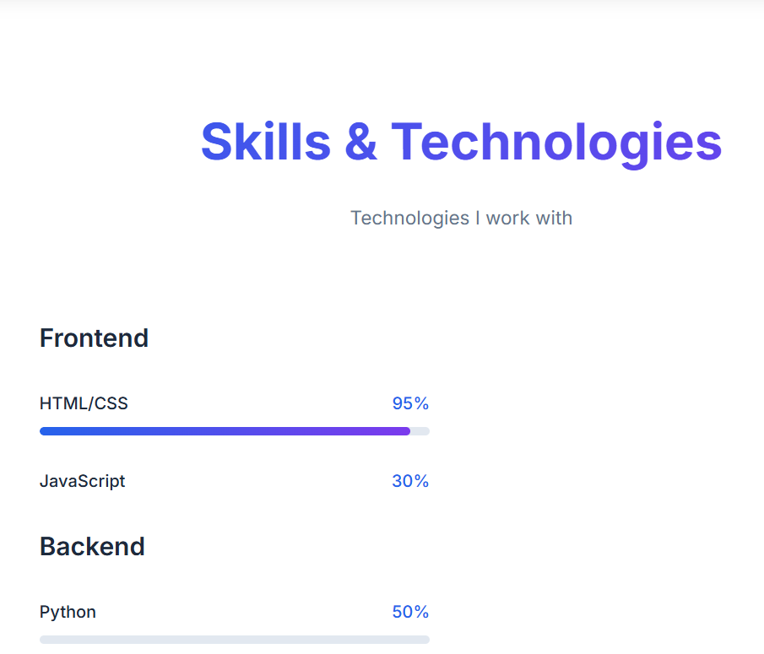
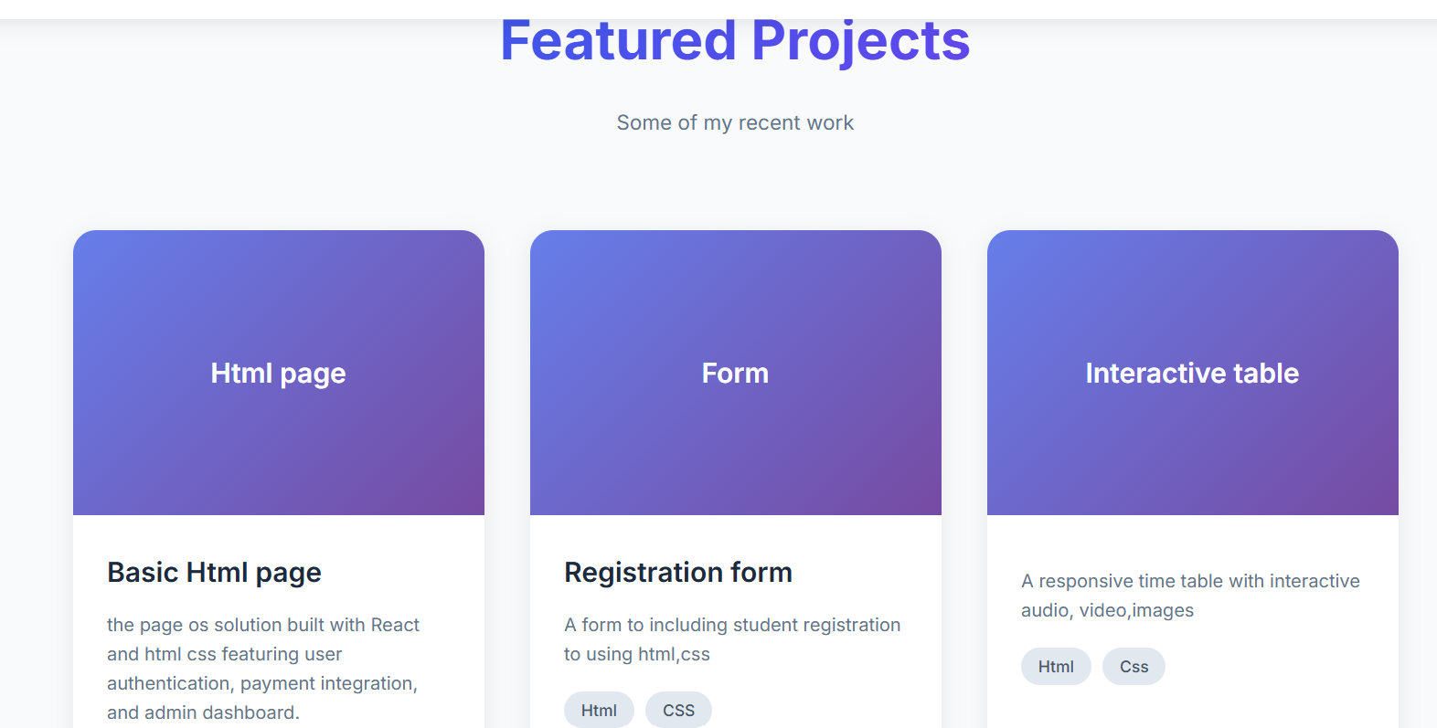
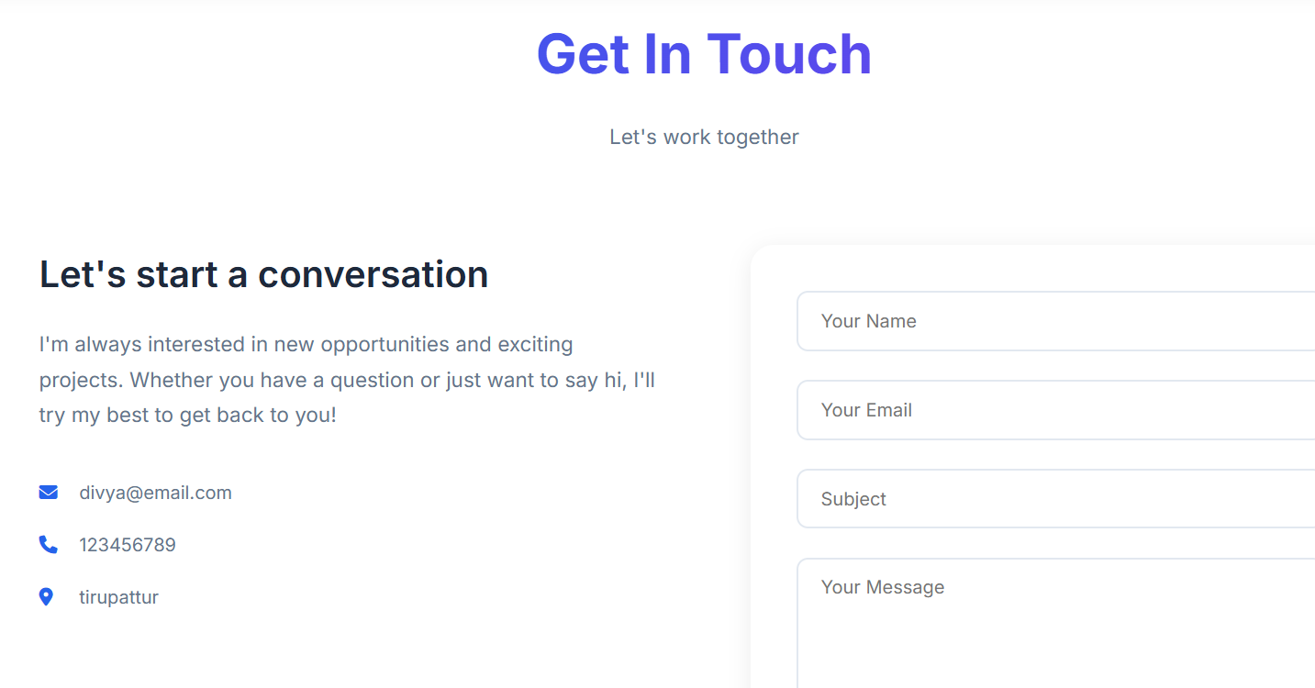
RESULTS AND SCREENSHOTS
3/21/2024 Annual Review
10

Slide 11


CONCLUSION
his portfolio website was designed and developed using HTML, CSS, and JavaScript to create a responsive, interactive, and user-friendly platform.
It allows others such as:
Employers and recruiters – to quickly view my skills, projects, and contact me.
Clients – to explore my past work and hire me for new opportunities.
Peers and collaborators – to connect and collaborate via social links and GitHub.
Thus, the project demonstrates not only my technical skills but also provides a professional online presence that is accessible to anyone, anytime.
11

